Slide 1
Christian Groups with a Purpose
Ros Turner
Transform Work UK

Slide 2
Christian Workplace Groups with a Purpose
Home Office first ever Christian conference
Allen & Overy Law Firm, breakfast with worship & word
Horton Hospital –humming connections
Chelmsford City Council Christian Fellowship – the dog collar effect
Defence Infrastructure Organisation Sutton Coldfield
E.ON Christian Network – conversation using diversity boards
Christians@Ford (Warley) – prayer, worship, word
Royal Mail Christian Network – currently engaging with HR
Teekay Offshore Production – witness in the North Sea
North Bristol NHS Trust CWG – grown through diversity

Slide 3
“Working with HR and being part of, and involved in the Diversity and Inclusion agenda within E.ON made this easier.”
E.ON Christian Network

Slide 4
Christian Workplace Groups with a Purpose
Home Office first ever Christian conference
Allen & Overy Law Firm, breakfast with worship & word
Horton Hospital –humming connections
Chelmsford City Council Christian Fellowship – the dog collar effect
Defence Infrastructure Organisation Sutton Coldfield
E.ON Christian Network – conversation using diversity boards
Christians@Ford (Warley) – prayer, worship, word
Royal Mail Christian Network – currently engaging with HR
Teekay Offshore Production – witness in the North Sea
North Bristol NHS Trust CWG – grown through diversity

Slide 5
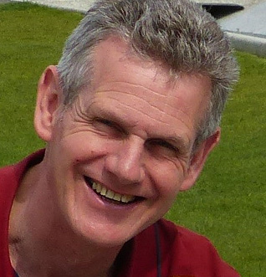
Sefton Council Christian Group
Our Vision statement :
Sefton Christian Workplace Group seeks to
provide a sense of belonging for Christians and to raise awareness of the Christian faith within the workplace.
It will encourage members to apply Christian principles to all aspects of their work,
to promote a culture of respect for the organisation, and
to value and support all work colleagues.
Steve Matthews

Slide 6
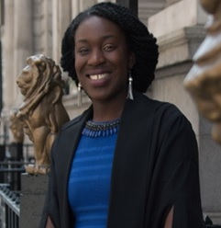
Barclays Christian Forum
Our Vision is to :
To enable Christians in Barclays to confidently express who they are in Jesus Christ while at work.
Be an agent of Christ centred change for the benefit of all colleagues.
Our Mission:
To facilitate forums whereby members can grow in community (citizenship), understanding and character.
To live out the company values and encourage good influence through right actions from the individual to the corporate level
Stephanie Amoah

Slide 7
BT Christian Network
Our Vision is to :
see individuals coming together to support each other
build a Spiritual wall around our company
Objectives are to:
act as a central reference point for Christian information in BT
provide a Christian perspective on business policy and strategies
support and encourage Christians in BT
Peter Davies

Slide 8
Christian Workplace Groups with a Purpose

Slide 9
Christians in HSBC

Slide 10
Christian Workplace Groups with a Purpose

